Slide 1

The Machine Learning Process
How do I select multiple rows and columns from a pandas DataFrame?
Dr. Reza Dibaj

Slide 2
Knowing more about the index
Different DF methods for selecting rows and columns:
DF.loc()
DF.iloc()
DF.ix()

Slide 3
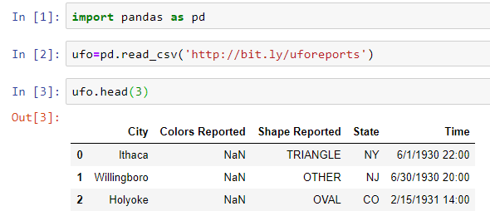
Knowing more about the index
Let’s pull up an example dataset as follows, this time showing the first 3 rows:
Notes:
import pandas as pd
ufo=pd.read_csv('http://bit.ly/uforeports’)
ufo.head(3)

Slide 4
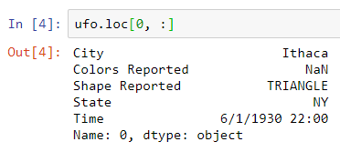

Knowing more about the index
loc() is a DF method for filtering rows and selecting columns by label.
Label for rows is index and for columns is column names.
DF.loc[what rows do I want, what columns do I want]
Notes:
ufo.loc[0, :]

Slide 5
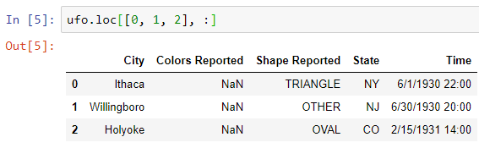
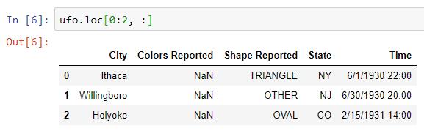
Knowing more about the index
What is we want multiple rows?
OR
Note that loc() is inclusive on both sides.
Notes:
ufo.loc[[0, 1, 2], :]

Slide 6
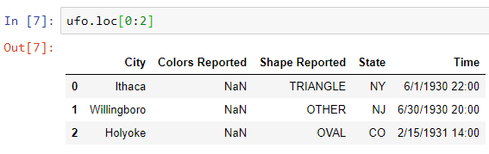
Question for Reza…
Q: What if we miss the column part? E.g.
R: Pandas considers the total column, i.e. it considers “:” as the default.
Not a good practice!
Notes:
ufo.loc[0:2]

Slide 7
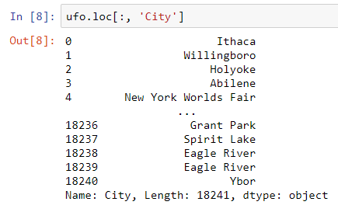
Knowing more about the index
What is we want column selection?
Notes:
ufo.loc[:, 'City']

Slide 8
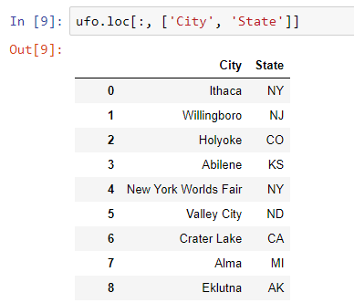
Knowing more about the index
And here is when we want multiple columns:
Notes:
ufo.loc[:, ['City', 'State']]

Slide 9
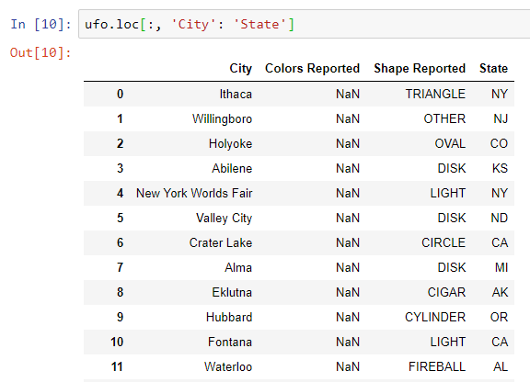
Knowing more about the index
Or we can specify columns as a range as follows:
Notes:
ufo.loc[:, 'City': 'State']

Slide 10
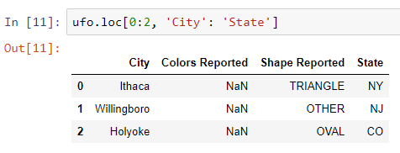
Knowing more about the index
And another example to use range for both rows and columns:
Notes:
ufo.loc[0:2, 'City': 'State']

Slide 11

Group Discussion
What other method we learned before that could do the same as the previous slide’s command?

Slide 12
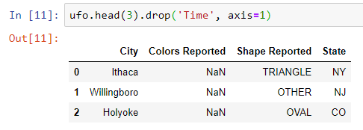
Knowing more about the index
And another example to use range for both rows and columns:
Notes:
ufo.head(3).drop('Time', axis=1)

Slide 13

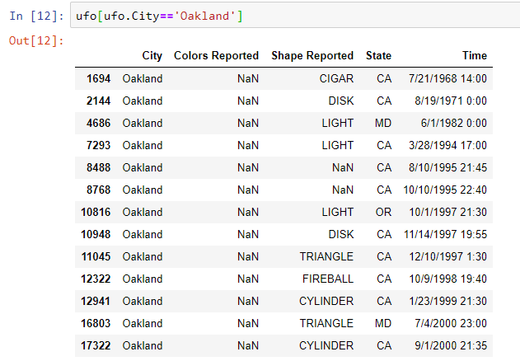
Knowing more about the index
Finding the rows that their “City” is “Oakland ….
Notes:
ufo[ufo.City=='Oakland']

Slide 14
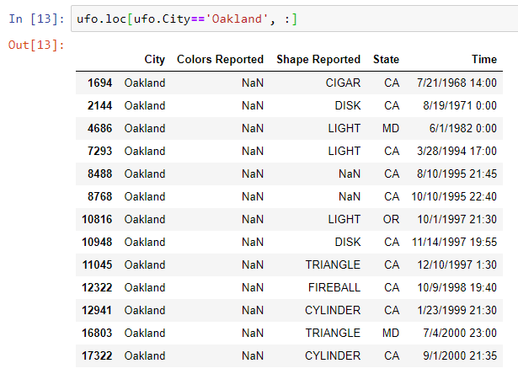
Knowing more about the index
We can get the same result with DF.loc with higher flexsibility:
Notes:
ufo.loc[ufo.City=='Oakland', :]
#What rows do I want? The rows that their City is Oakland.
#What columns do I want? All comulm

Slide 15
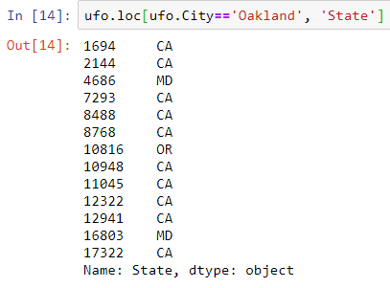
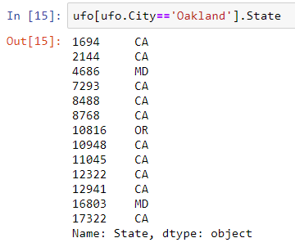
Knowing more about the index
And you can easily customize it, thanks to DF.loc() flexibility.
And this can be done with our previous knowledge as well

Slide 16
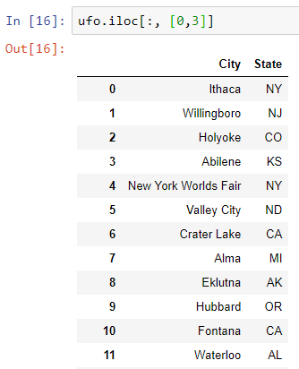
Knowing more about the index
DF.iloc() is for filtering rows and columns by integer position.
Notes:
ufo.iloc[:, [0,3]]

Slide 17
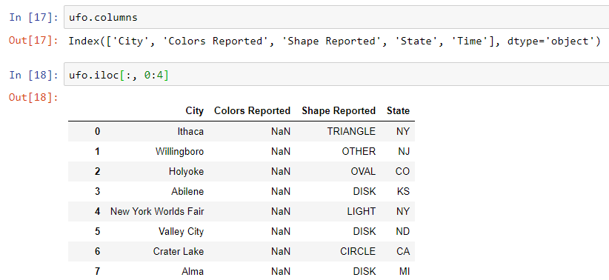

Knowing more about the index
And we can use it for a range of columns, considering that it is exclusive of the second number:
The same as this concept
Notes:
ufo.columns
ufo.iloc[:, 0:4]

Slide 18

Knowing more about the index
In DF.loc() → Inclusive of both sides
Whereas
In DF.iloc() → Exclusive of the second number
Notes:
ufo.iloc[:, [0,3]]

Slide 19
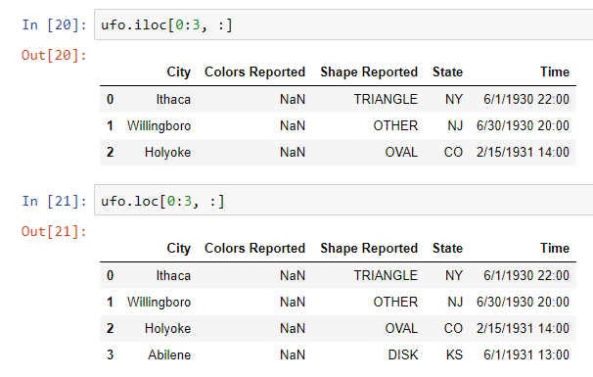
Knowing more about the index
One more example of DF.iloc():
Notes:
ufo.iloc[0:3, :]
ufo.loc[0:3, :]

Slide 20
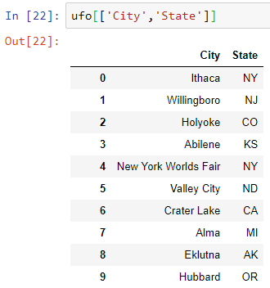
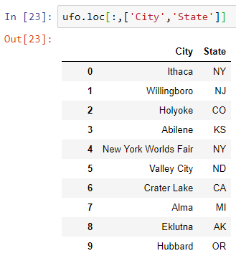
Knowing more about the index
Which one do you prefer? Why?
VS
Notes:
ufo[['City','State']]
ufo.loc[:,['City','State']]

Slide 21
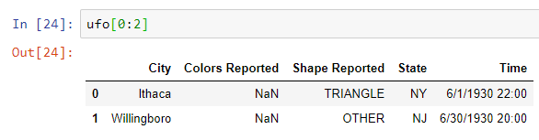
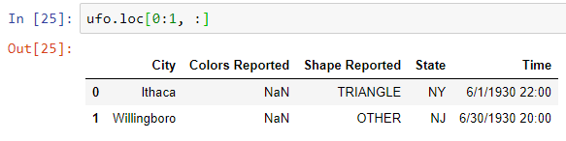
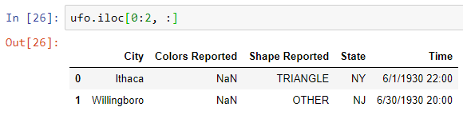
Knowing more about the index
Which one do you prefer? Why?
VS
VS
Notes:
ufo[0:2]
ufo.loc[0:1, :]
ufo.iloc[0:2, :]

Slide 22
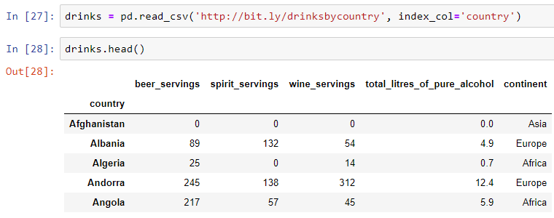
Knowing more about the index
For selection, DF.ix() allows you to mix labels and integers.
Let’s pull up an example dataset as follows and check what is new?
Notes:
drinks = pd.read_csv('http://bit.ly/drinksbycountry', index_col='country’)
drinks.head()

Slide 23
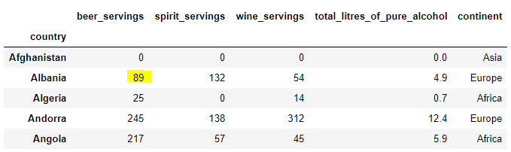
Knowing more about the index
What if I want to select the highlighted cell in the DF using DF.ix()?

Slide 24
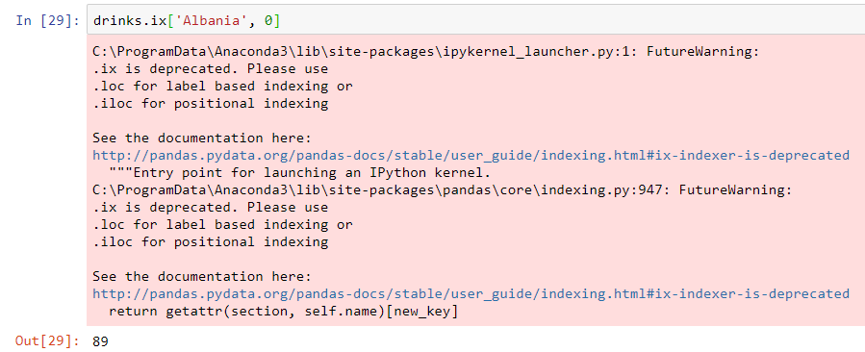
Knowing more about the index
Here is the result…. Kind of outdated command, but good to know for understanding others’ code.
Notes:
drinks.ix['Albania', 0]

Slide 25
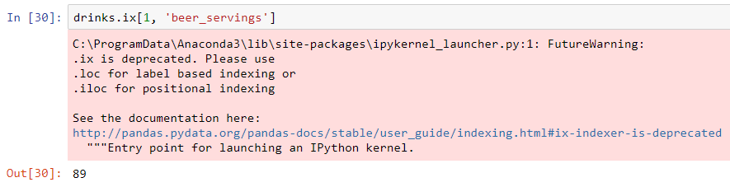
Knowing more about the index
Another way…. Kind of outdated command, but good to know for understanding others’ code.
Notes:
drinks.ix[1, 'beer_servings’]
#ix() should guess whether the parameter is a position or label.

Slide 26
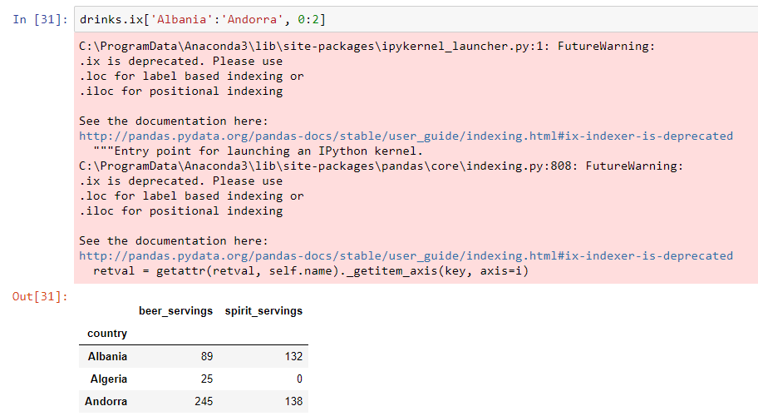
Knowing more about the index
Another example of using ix. It exclude the end position as follows:
Notes:
drinks.ix['Albania':'Andorra', 0:2]

Slide 27
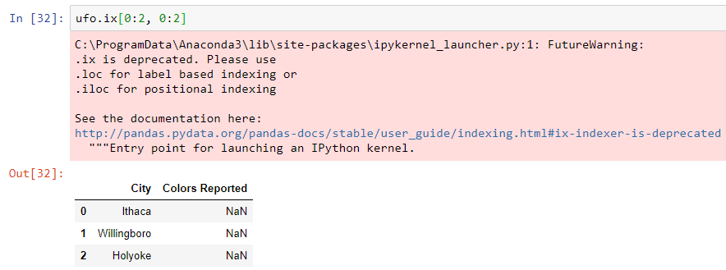
Knowing more about the index
Another example… A funny one! Can you see any logic in this one?
Notes:
ufo.ix[0:2, 0:2]

Slide 28

Bonus Tip
Use DF.ix() ONLY if you have to!
Otherwise, enjoy using DF.loc() or DF.iloc().

Slide 29

Thank you
Question?
To be
Not to be

